Slide 1
Smart Stock Inventory Optimization for Retail Stores
Presented By:​​ Rudrakshi Jaiswal
Guided By:​
Shakthi Gopalakrishnan

Slide 2
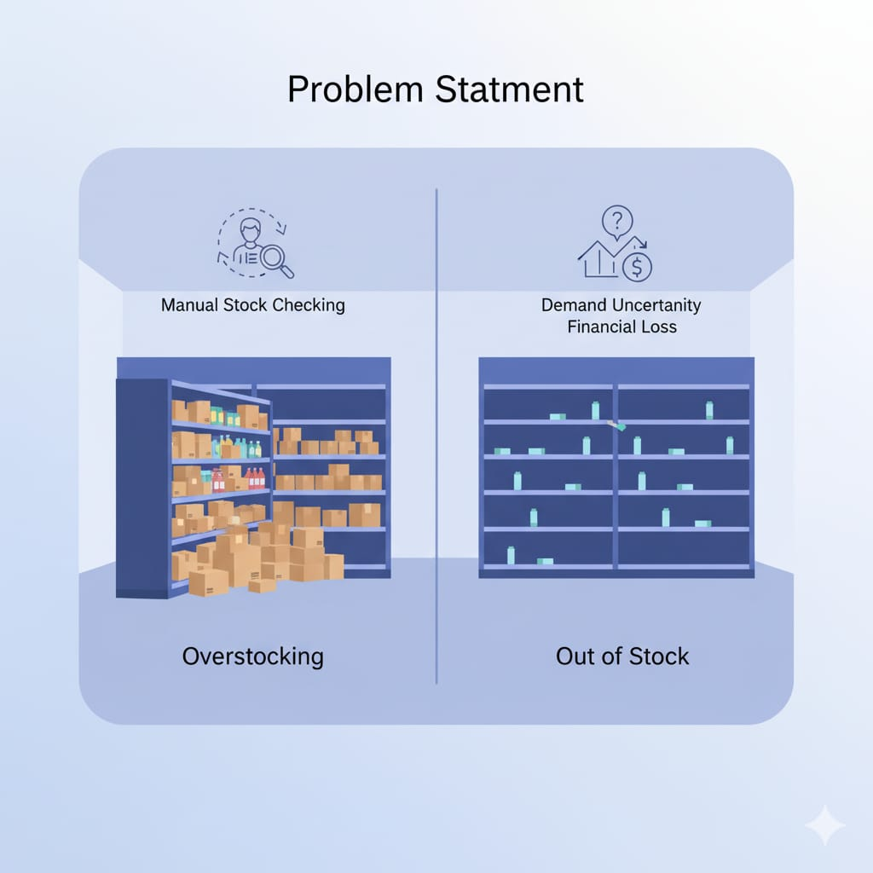
Problem Statement
Retail stores commonly face: • Overstocking and blocked capital • Understocking and lost sales • Manual tracking errors • Poor demand forecasting • Inefficient ordering cycles
This system aims to solve these issues using data and automation.

Slide 3
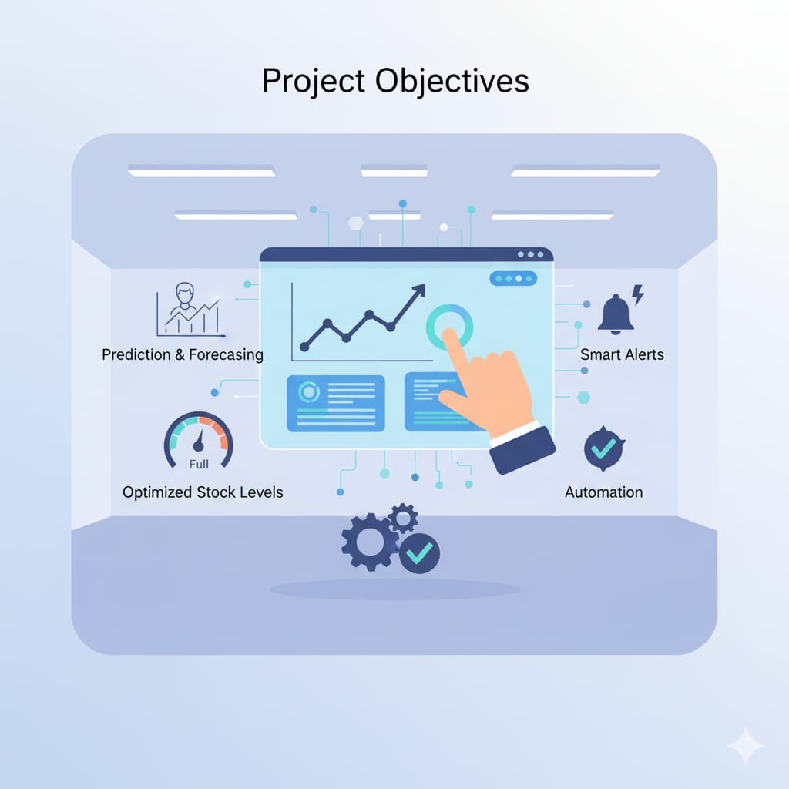
Project Objectives
• Predict future product demand • Suggest optimal stock levels • Send automatic low/high stock alerts • Reduce manual work • Improve decision making • Increase store efficiency and profitability

Slide 4
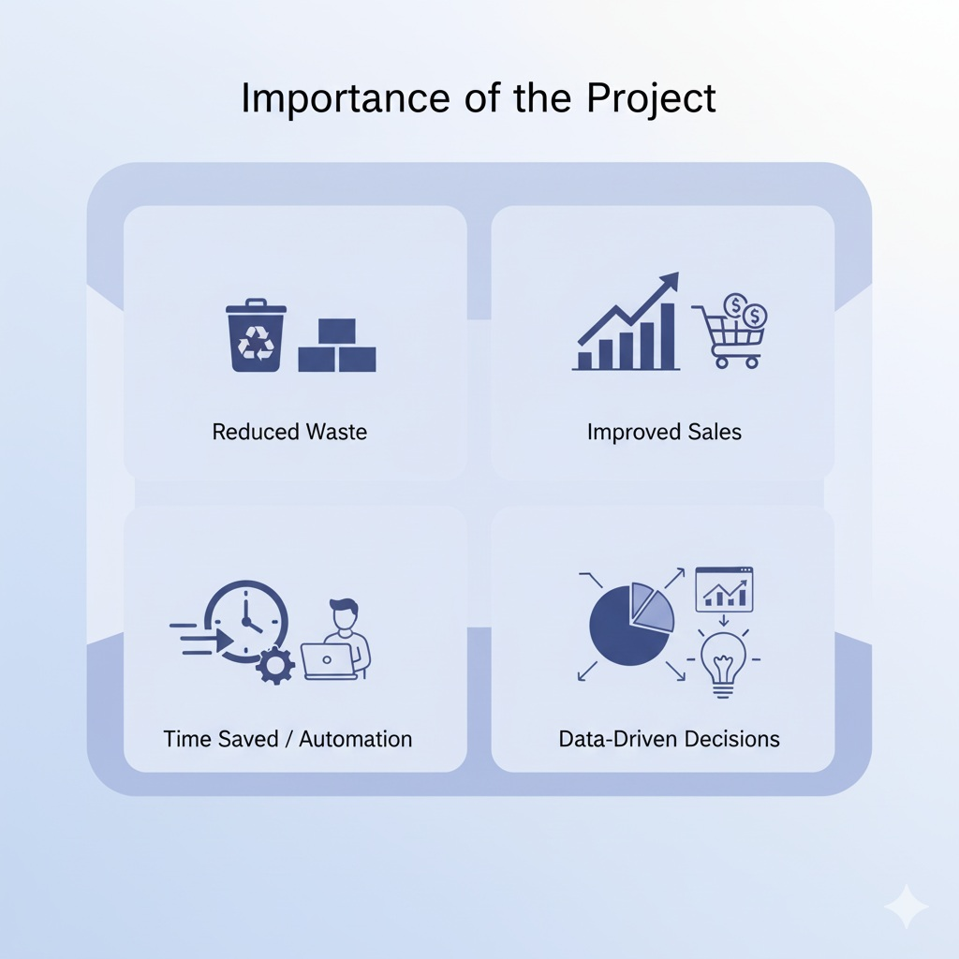
Why This Project Is Important
• Prevents losses from out-of-stock items • Reduces wastage from unsold products • Saves time with automated tracking • Encourages data-driven planning • Works well for single or multiple stores

Slide 5
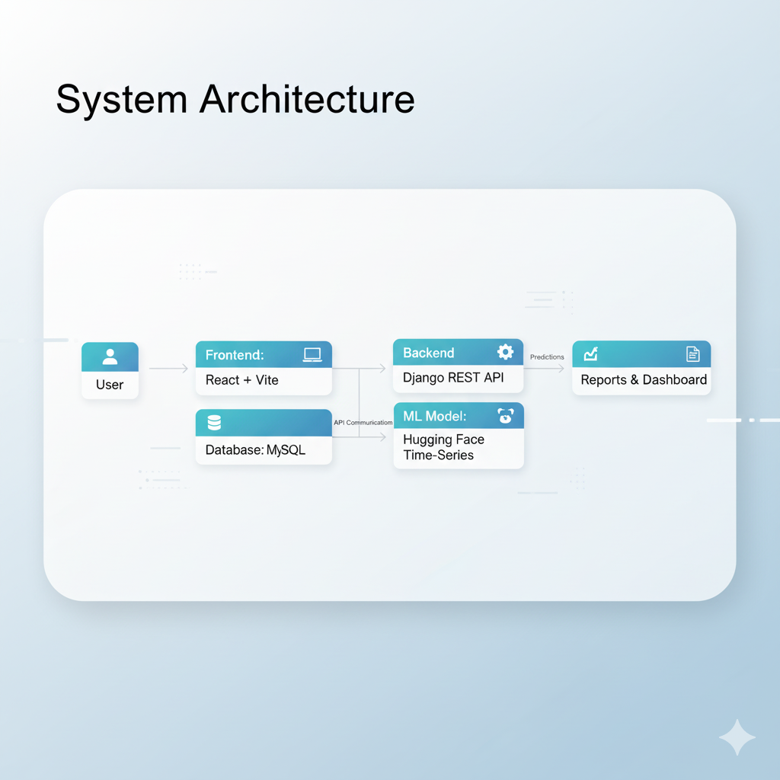
System Architecture
Frontend: React + Vite Backend: Django REST API Database: MySQL Model: Hugging Face time-series forecasting

Slide 6
Key Modules
Product Management
Stock Tracking
Sales Data Import
Demand Forecasting (AI Model)
Auto Stock Alerts
Reports and Analytics
User Authentication

Slide 7
Tech Stack Summary
Frontend: React+ Vite
Backend: Django
Database: MySQL
Dataset Source: Hugging Face – Retail Sales Time Series

Slide 8
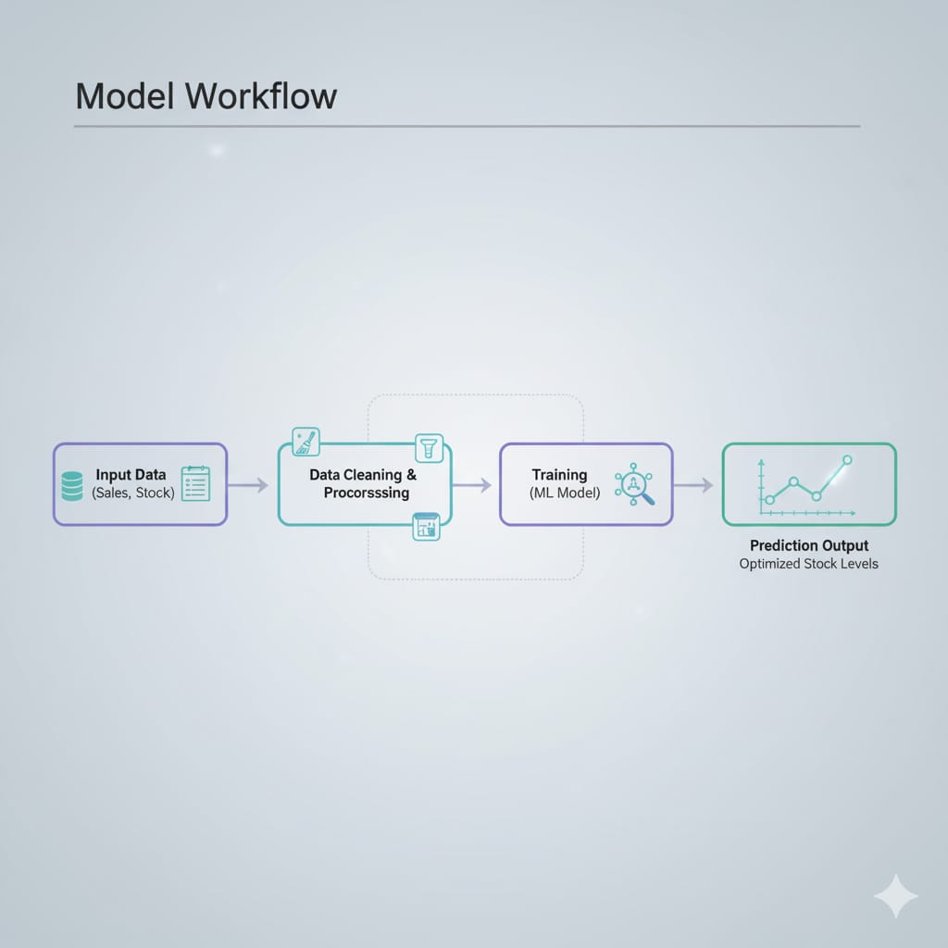
Model Workflow
• Load historical sales data • Clean and preprocess dataset • Perform train/test split • Apply forecasting model • Generate future predictions • Show results in dashboard charts

Slide 9
Expected Outcomes
• Accurate stock planning • Better profit margins • Lower inventory holding cost • Reduced manual work • Clear insights through charts and reports

Slide 10
Future Enhancements
• Real-time POS data integration • Multi-store comparison dashboards • Auto purchase order generation • RFID-based live stock tracking • Cloud database support

Slide 11
Conclusion
This system helps retail stores manage inventory smarter with the help of data and machine learning. It improves accuracy, saves time, and supports better business decisions.

